Slide 1

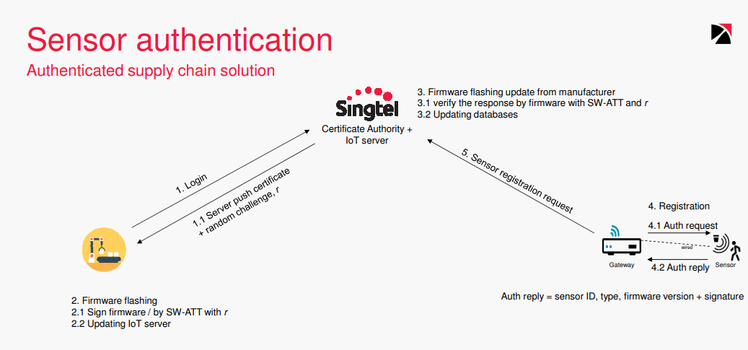
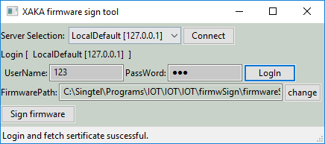
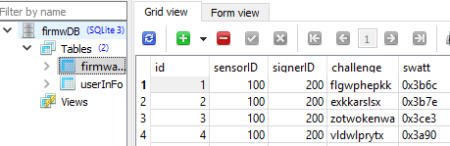
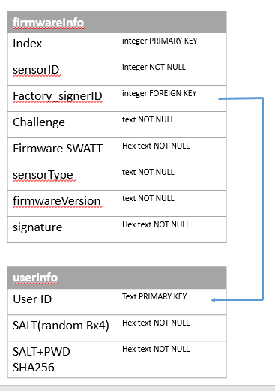
IOT Project Progress Report
Liu YuanCheng
2.1OI hardware architecture
Design by JunWen
Finished tasks:
Firmware sign client
Firmware Sign program user interface.
User authorization.
OpenSSL client setup + certificate file fetch
Firmware selection + Firmware SWATT value calculation based on server’s random challenge
firmware sign function + communication data packaging.(dump + load)
Firmware sign Server
OpenSSL server setup
User management + authorization
Firmware sign cert sending.
Firmware sign feed back data check and storage.
Data base management.

Slide 2
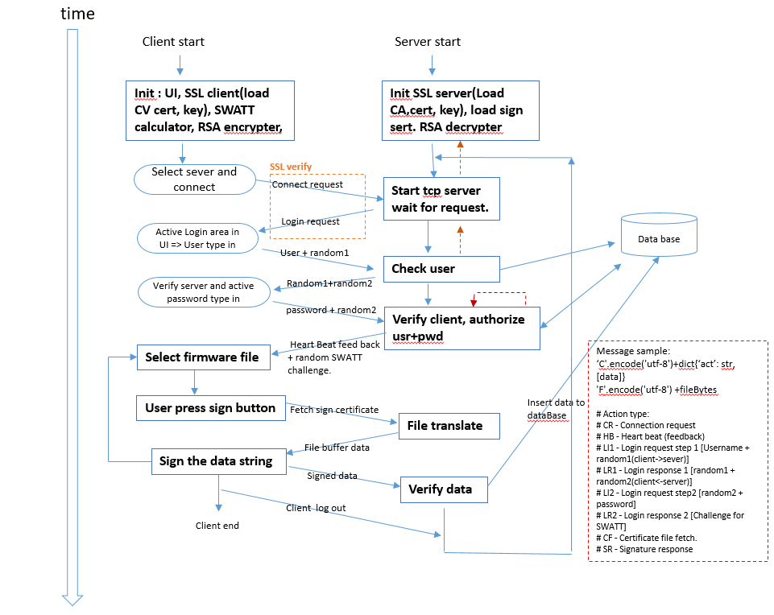
IOT Project Progress Report
Liu YuanCheng
2.1OI hardware architecture
Project Code:
Dev Env: python 3.7
Run Env: [2.7-3.7]
Code and Document Format: PEP-8
Addition lib need to install: wxpython 2.8, openssl, pysqlite3, ckPython(chilkat)
GitHub link: https://github.com/LiuYuancheng/IOT/tree/master/firmwSign
Files:
firmwareSign.py [main client program]
firmwMsgMgr.py[message manager to dump the user message load back to original data]
firmwTLSclient.py[SSL comm client]
firmwTLSserver.py[SSL comm server]
firmwDBMgr.py[database manager]
firmwdb.db[sqliteBD file]
firmwareSignServer.py[server]
IOT_Att.py [File SWATT calculate]
x509cReader.py[cert read+verify]
Certificate folder[SSL cert+CA+key]

Slide 3
IOT Project Progress Report
Liu YuanCheng
2.1OI hardware architecture
Week6 Main the basic client + server
Week5
DB + Optimize code+ comm
now
Project TimeLine:
Client UI
Server .
Certificate verify .
Sign function.
SWATT calculate(follow Mohamed Haroon Basheer’s IOT_ATT project)
Data base.
User authorization part.
SSL client+ server
Sign data verify
ByteIO for certificate(load in memory).
Communication message protocol.
Message dump and load.
Part of the code document.
Code modulize.
Part of the testCase()
Program optimize.
Code document.
testCase()

